Slide 1
City Guide
(Traffic monitoring made easy!!)
Presented By,
Arun Kumar
Labhesh Deshpande
Manasa Potnuru
Sidharth Bhasin

Slide 2
Agenda
Introduction
Project Architecture & Infrastructure
Users’ Dashboard and their interactions
Sensor Control and Management
Billing components for sensing and data services
Load Balancing & Scalability Management
Demo for IaaS.
Demo for an example SaaS application.

Slide 3
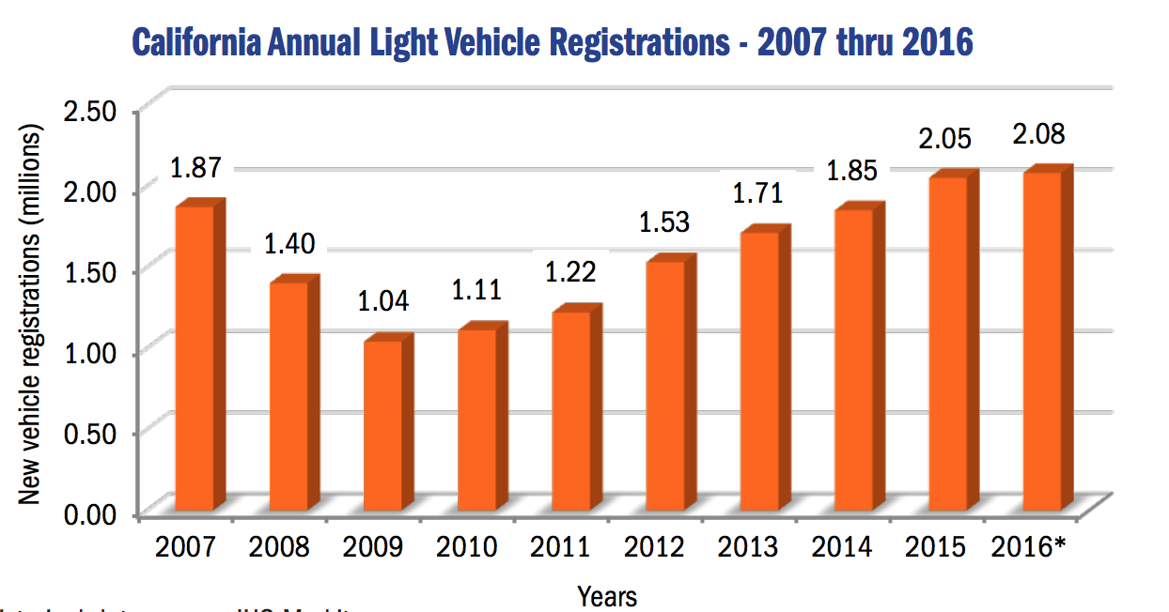
Introduction
Problem:
Increasing vehicle traffic on roads.
20,437 lives lost between 2010 & 2016 due to traffic accidents.
Traffic monitoring is becoming increasingly difficult.

Slide 4
Solution: CityGuide!!!!
A mobile sensor Infrastructure As a Service.
Provides traffic monitoring by deploying mobile sensors dynamically.
Issue patrol requests in required regions.
Pay as you use service model.
Easy interface and dashboard to use and monitor services you use.
Provides virtualization, load balancing and scalability.
FLIR Detectors mounted on VTA buses.

Slide 5
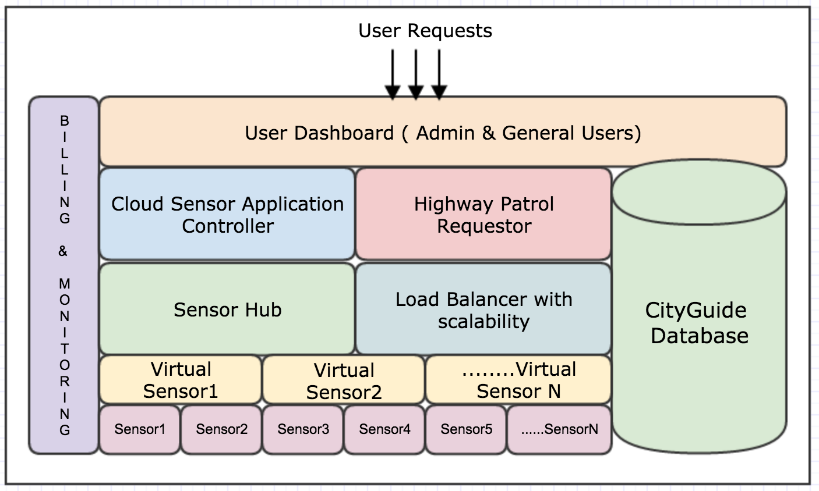
Architecture

Slide 6
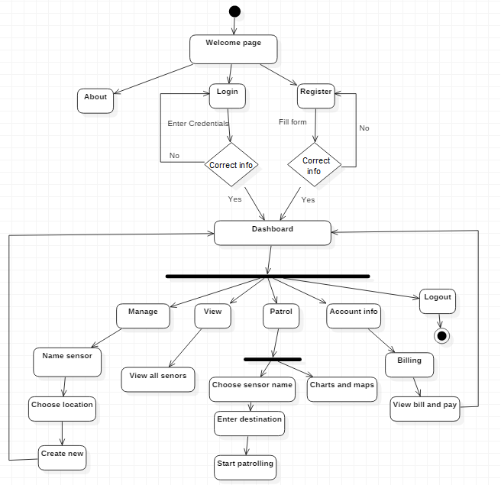
User Flow :

Slide 7
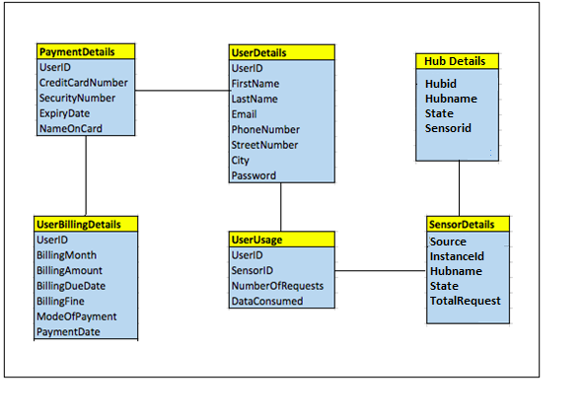
Database Design (Sensor table)

Slide 8
DASHBOARD

Slide 9
What constitutes Dashboard?
Entire website design for user and admin.
Intuitive design of the dashboard to maintain user’s interest.
Abstraction of underlying mechanism.

Slide 10
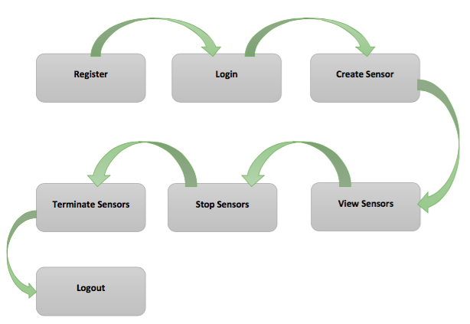
Workflow Diagram

Slide 11
Sensor Control Management

Slide 12
Sensor control Management
Base controller which controls entire operation of system.
It includes control for,
Virtual sensor allocation/deallocation
Monitoring Virtual Sensors
Creating new virtual sensors on-demand
Facilitate Billing part for the allocated virtual sensors

Slide 13
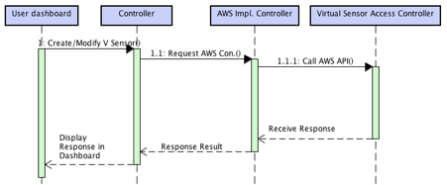
Virtual Sensor Management

Slide 14
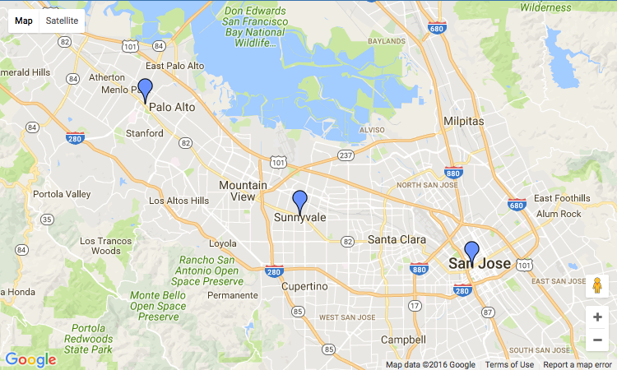
Created Sensors

Slide 15
Load Balancing and Scalability Support

Slide 16
What is LB?
Distributes user requests or network load efficiently across multiple servers.
Provide high availability and reliability by sending requests only to servers that are up.
Provides the flexibility to add or subtract servers as per demand.

Slide 17
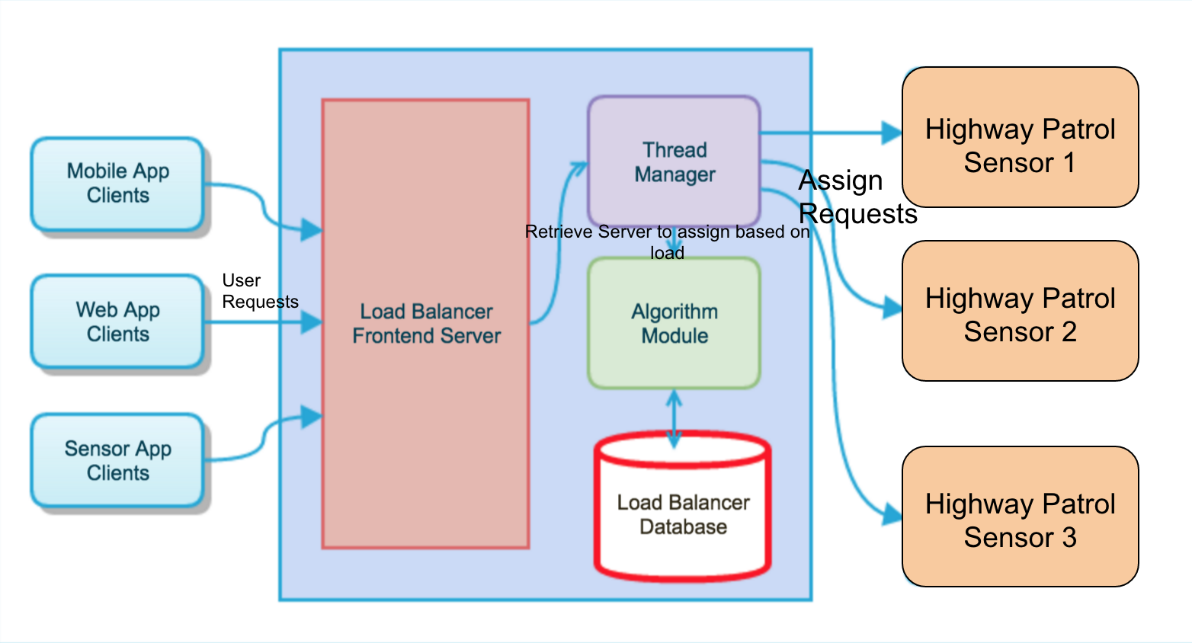
Component Diagram
Notes:
Sensor cloud user sends request. Load balance server receives it
Load balancers are multi threaded application, so assign a thread to the incoming request.
Ignore the incoming request if it not for sensor cloud services.
Based on incoming request algorithmically decide which backend sensor in the hub to send the incoming request.
Update global data structure to reflect the recently assigned server
Monitor backend servers regularly and update the active available server.

Slide 18
Algorithms:
Round robin: Assign requests to the sensors in the hub in an order.
Least Network Connections: Assign request to sensor with least number of connections in it.
Deterministic Source: Assign request to sensor based on hash of source IP of the sensor.

Slide 19
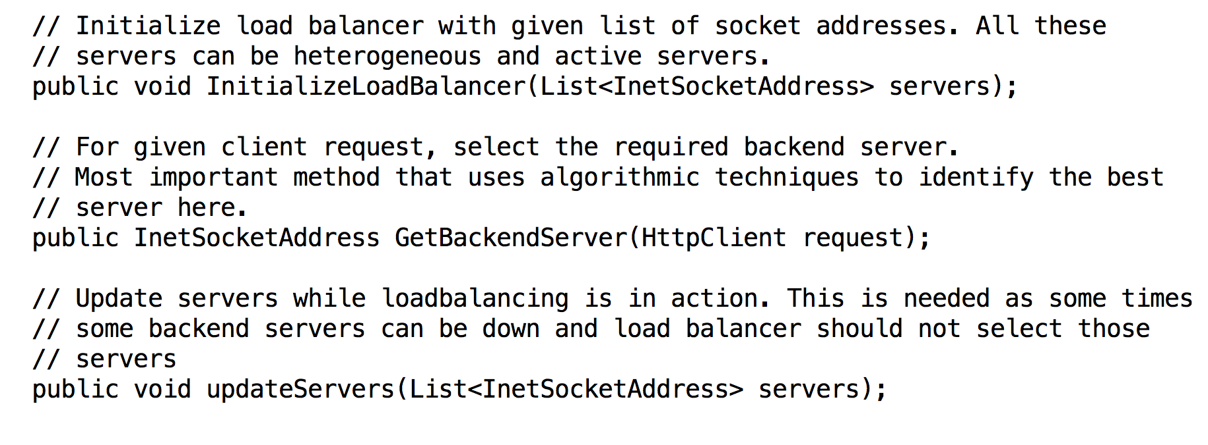
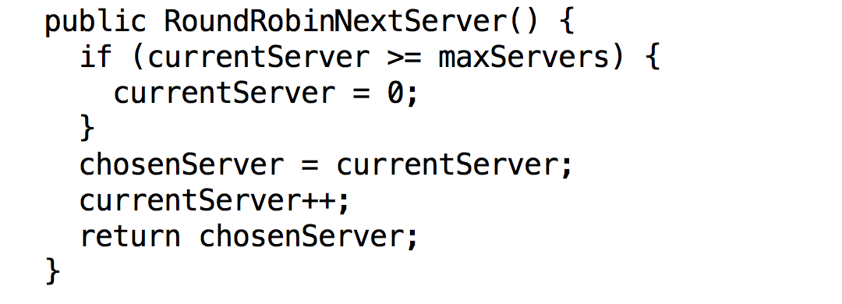
...contd

Slide 20
Scalability:
Automatically allocate and deallocate sensors based based on load.
Amazon autoscaling API to achieve scalability.
Some 3rd party tools available to achieve load balancing:
HaProxy
Linux Virtual Servers
Ngnix
Notes:
HaProxy : Can change configuration files to determine no. of requests, algorithm to use and specify IP addresses
Linux Virtual Servers : A layer 4 load balancer in linux distributions
Ngnix : A web server for proxy and load balancing solutions. Used in conjunction with HaProxy

Slide 21
Billing Module

Slide 22
Billing Module?
Billing Module generates income for the Infrastructure providers.
Cost Model - Consumption cloud costs.
Pay As you Go.
Billing involves using actual consumption time of the resources.

Slide 23
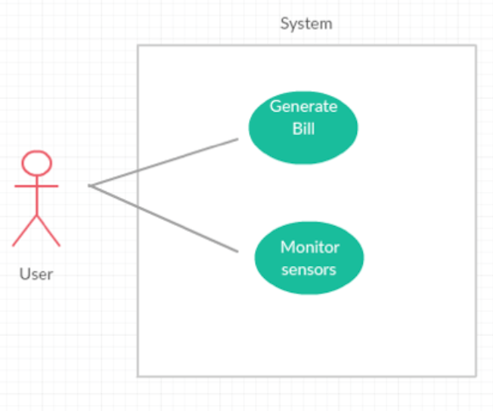
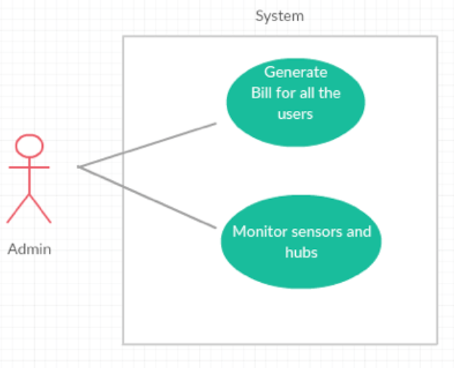
Use Case for Billing Part

Slide 24
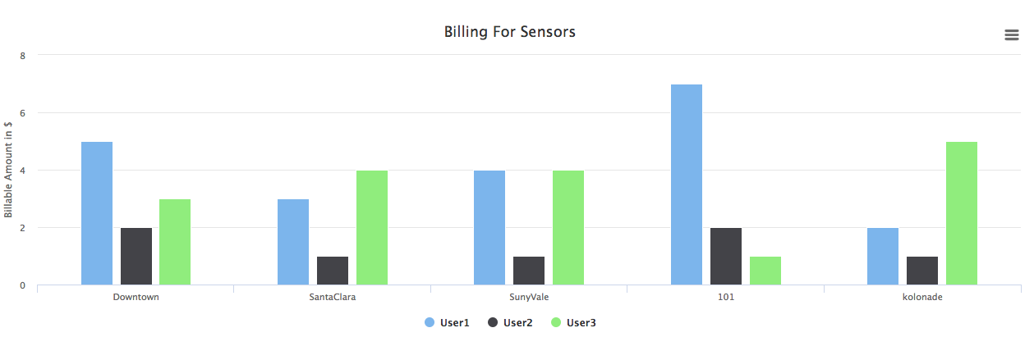
Billing Chart

Slide 25
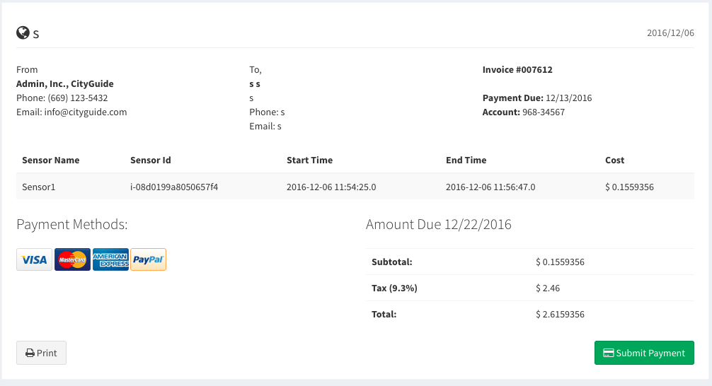
Billing Report

Slide 26
Technologies & Tools Used:
J2EE
Amazon EC2
Amazon RDS
Google Map API
Highcharts
Gliffy

Slide 27
Conclusion & Future Enhancements:
City Guide - A mobile sensor IaaS.
Traffic monitoring made easy.
A virtualized, dynamic, scalable,pay-as-u-go with easy interface.
Some future enhancements can be:
A mobile app for our service.
Deploy sensors on drones instead of VTA.
Achieve better load balancing and scalability.

Slide 28
Demo:
CityGuide: https://www.youtube.com/watch?v=gOoUCwdF7qI&t=1s
Example SaaS on CityGuide: https://youtu.be/xkMTSGvvNtQ

Slide 29
References:
CA Auto Outlook Nov 2016: http://www.cncda.org/Auto_Outlook.asp
HaProxy: https://www.digitalocean.com/community/tutorials/an-introduction-to-haproxy-and-load-balancing-concepts
FLIR Sensors: http://www.flir.com/traffic/display/?id=67443

